Slide 1
Reviewing civilian Medical records
Matt Wilcut
Sutton Snipes
Notes:
Starting Assumptions: Near Perfect Set of Records Obtained After Early Client Interview

Slide 2
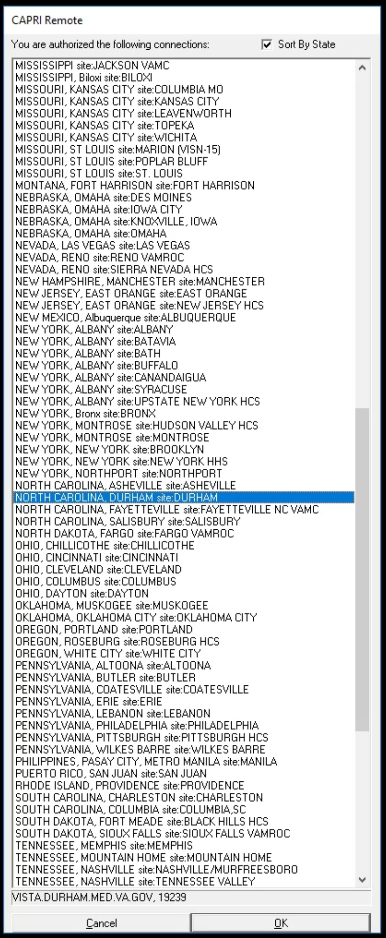
Reviewing VA Medical Center Records
Notes:
Benefit of Electronic Access – CAPRI – lets you know all the visited facilities (EXCEPT vet centers)
Niche: Quality-Assurance Records (like 1151 or missed/mistaken diagnosis)

Slide 3
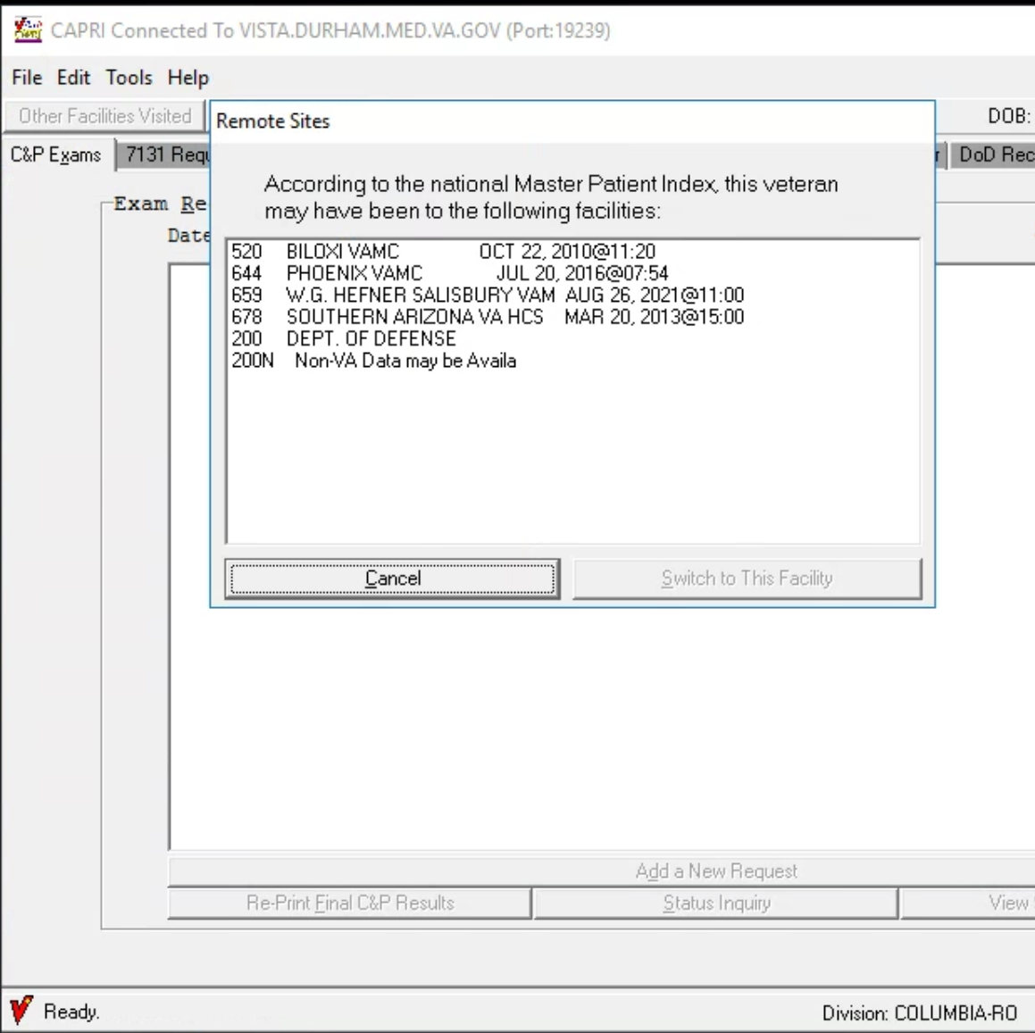
Master patient index
Notes:
Benefits of CAPRI Access for VAMC MR (or files from CAPRI added to claims file)

Slide 4
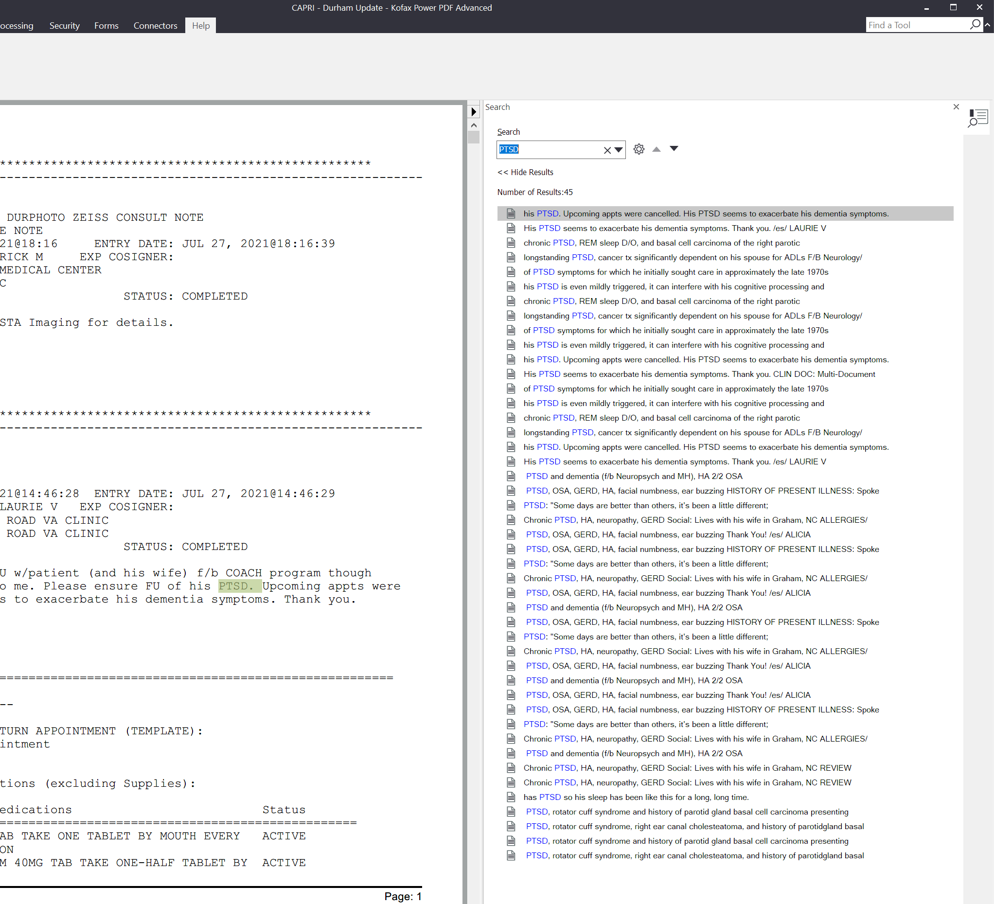
ALREADY IN OCR FORMAT FOR QUICK SEARCHING
Notes:
Benefits of CAPRI Access for VAMC MR (or files from CAPRI added to claims file)

Slide 5
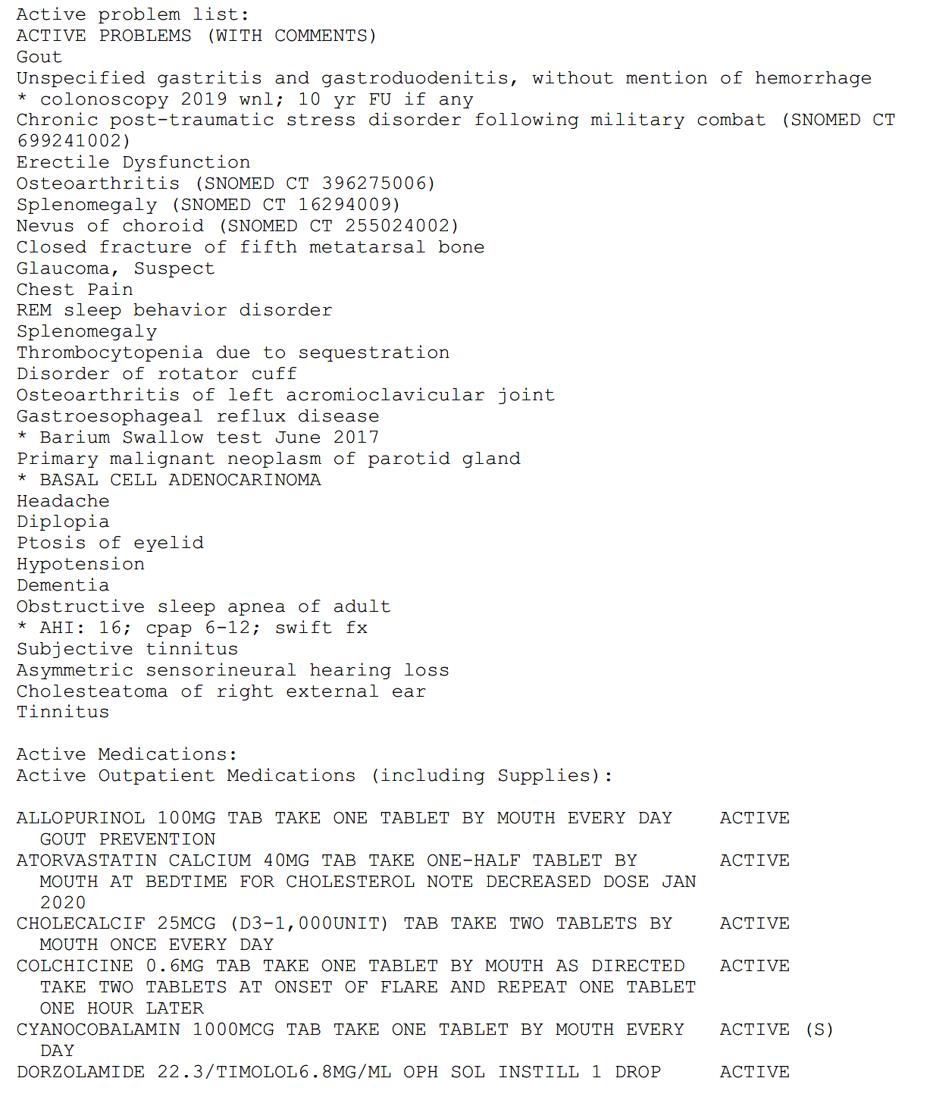
Problem list
Notes:
CAPRI ONLY PRINTS ACTIVE FOR NOTES
BUT AN INACTIVE LIST IS AVAILABLE
Consider also using the va codesheets in the file

Slide 6
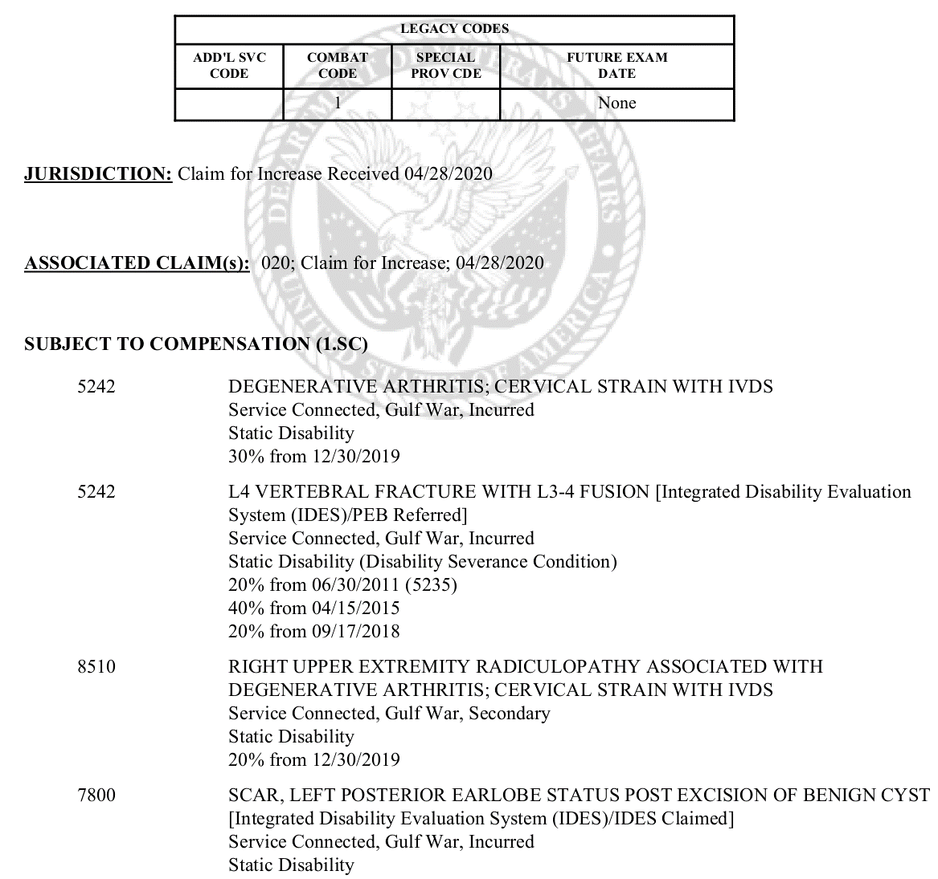
CODESHEET
Notes:
CAPRI ONLY PRINTS ACTIVE FOR NOTES
BUT AN INACTIVE LIST IS AVAILABLE
Consider also using the va codesheets in the file

Slide 7
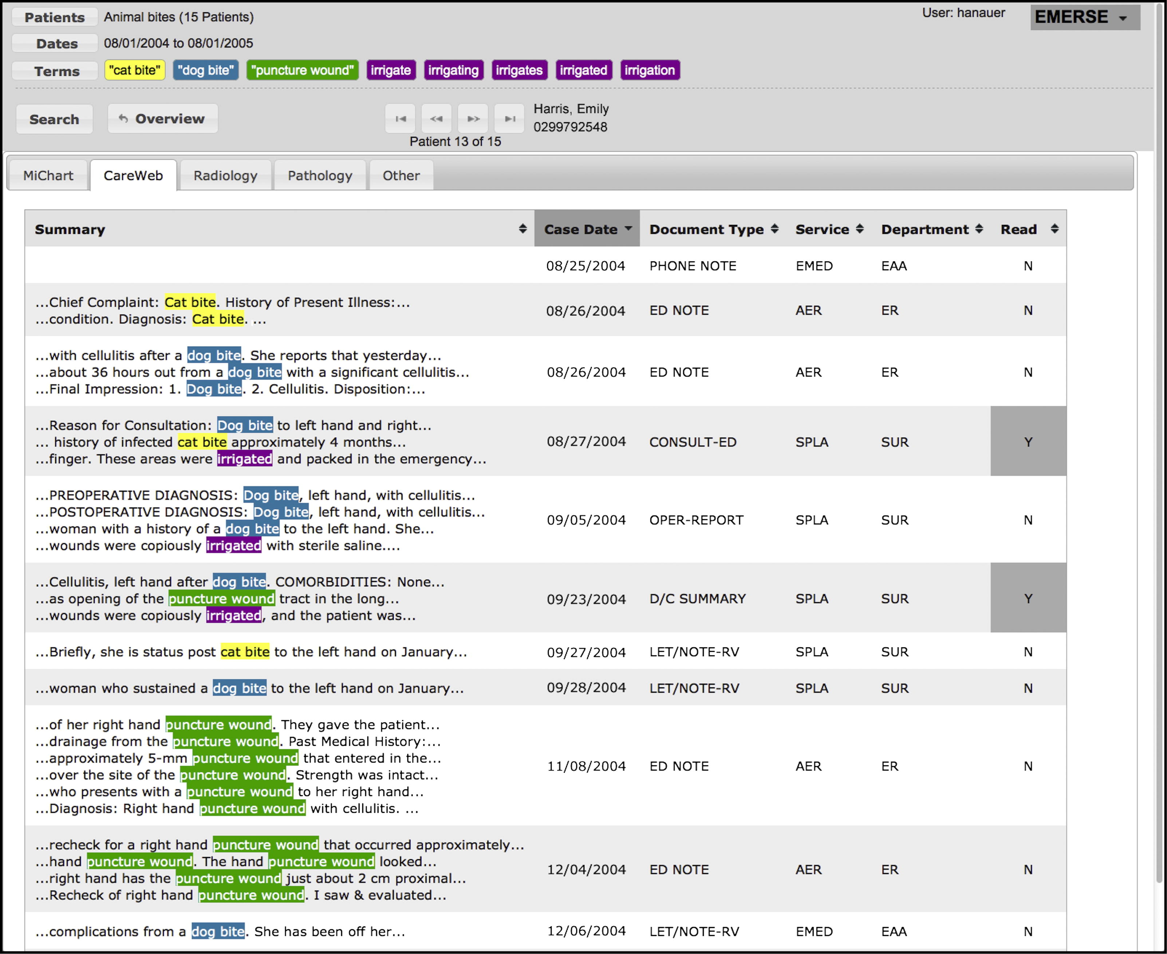
Keywords
How or why
Medical descRIPTION
treatment
Notes:
Benefits of CAPRI Access for VAMC MR (or files from CAPRI added to claims file)

Slide 8
Reviewing PRIVATE PROVIDER RECORDS
Notes:
Benefit of Electronic Access – CAPRI – lets you know all the visited facilities (EXCEPT vet centers)
Niche: Quality-Assurance Records (like 1151 or missed/mistaken diagnosis)

Slide 9
Building chronologies
Notes:
Benefit of Electronic Access – CAPRI – lets you know all the visited facilities (EXCEPT vet centers)
Niche: Quality-Assurance Records (like 1151 or missed/mistaken diagnosis)

Slide 10
Based on purpose/use
AUDIENCE
For Clinic/Office File Only?
For Review by a Medical Professional (DBQ or Nexus?)
CLAIM TYPE
Service Connection? May be a “full” chronology
Increased evaluation? May not be as “full”
1151 tort claim? Maybe only need to establish baseline prior to tort [I don’t handle 1151s – MW]
INTENDED FOR SUBMISSION
Consider citations that include the submitted date or VBMS labeling of all other evidence
NOT “In Dec 12, 2012 VA medical records, it was noted…”
BUT “01/01/2013 – CAPRI.pdf” (Salisbury) (p.5-10/95)
(bulleted UNDER that umbrella)
“Mar 3, 1993 – ‘may require surgery eventually’”
“Dec 12, 2012 – surgery performed on r knee”
Page numbers help with pdfs split across same date
You can repurpose this format to fit other needs or vice versa
If I was going to request nexus and include chron to help assist reviewer, I would prioritize their ease of review
Your clinic may already have a preferred template to work from, but if not…look at Holly’s example! It’s great!
Notes:
Benefits of CAPRI Access for VAMC MR (or files from CAPRI added to claims file)

Slide 11
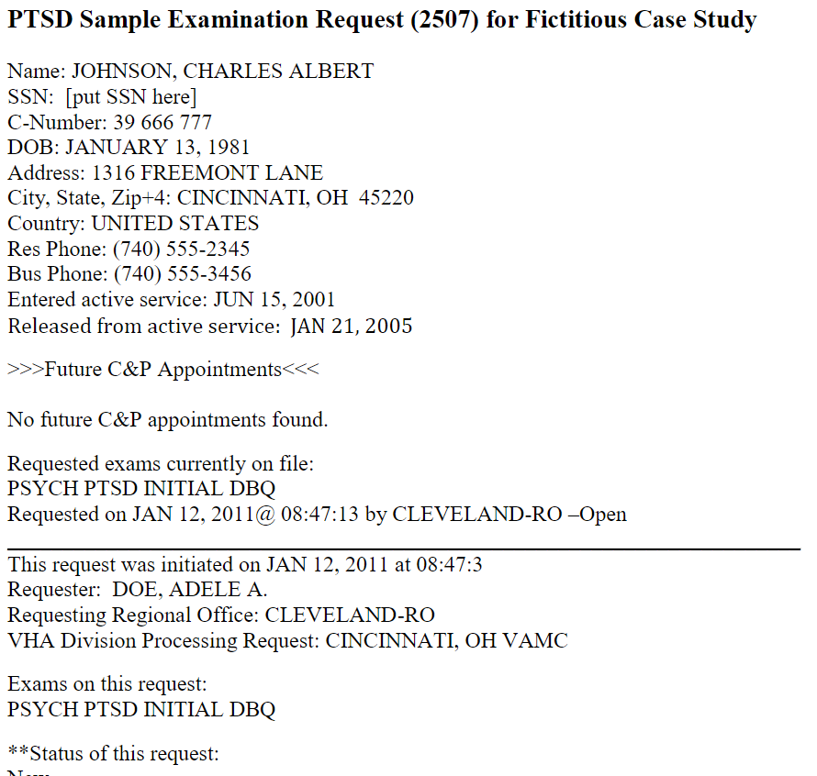
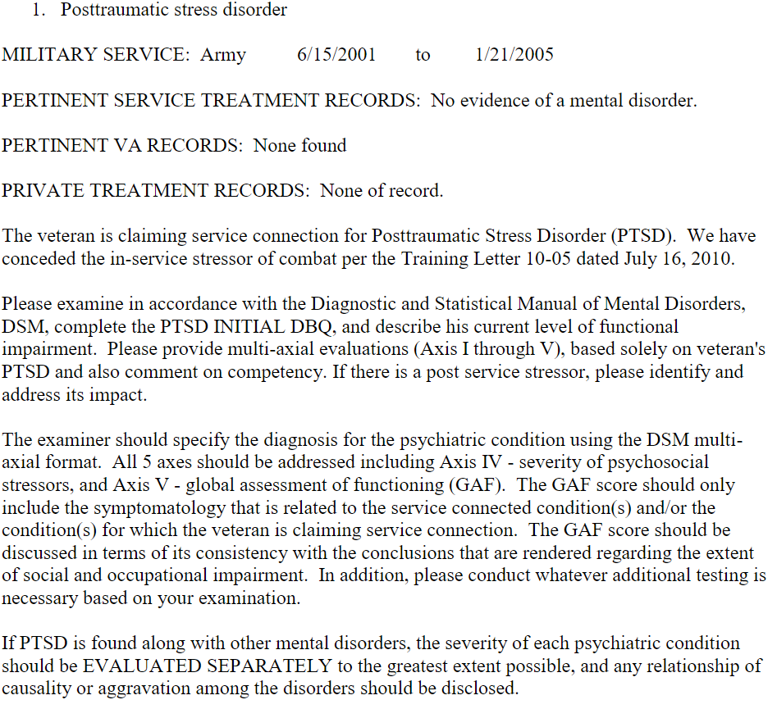
Va’s chronologies for exam purposes – usually not great examples to build on (2507 request for physical examination)
Notes:
Benefits of CAPRI Access for VAMC MR (or files from CAPRI added to claims file)

Slide 12
MISC. TIPS
Dieter Ram’s Principles of Good Design
Moves the claim forward
Useful for an audience of many
Easily understandable
Honest
As future-proof as possible
Detailed, but…
Simple
Take advantage of school/law library medical reference materials
- VA has an internal interactive medical tool but that’s not much help for students
Notes:
Benefits of CAPRI Access for VAMC MR (or files from CAPRI added to claims file)

