Slide 1
Shaping the Narrative for Veterans
Developing the Theory of the Case in the Papers and Beyond
Meghan Brooks, Michael J. Wishnie
Veterans Legal Services Clinic
Jerome N. Frank Legal Services Organization
Yale Law School

Slide 2
Overview
What is case theory?
Narrative Structure
Applying Case Theory
Opposition Research
Breakout Groups
Discussion
Conclusion

Slide 3
What is case theory?
Organizing principle
Narrative arc
Line of Reasoning/Argument
Not static – new facts, new law
Prioritize theories if multiple

Slide 4
What influences case theory?
Client’s goals
Legal rules
What facts are most persuasive?
What facts are good or bad for your client?
What’s the best “fit” between law & facts?
Intelligibility
Emotional appeal v.
Simplicity v. complexity
Thinking ahead to appeal
Timing concerns

Slide 5
Narrative Theory (Western)
Steady State
Trouble
Hero
Temptation
Resolution/Steady State
Who are the potential characters in your case?
Who do you actually want to cast? In what roles?
Notes:
Closing arguments, criminal trial – time & place of crime v. trial
Where are race, gender, disability, etc? If not us, who?
Intentional v. negligent wrongdoing

Slide 6
Applying Case Theory

Slide 7
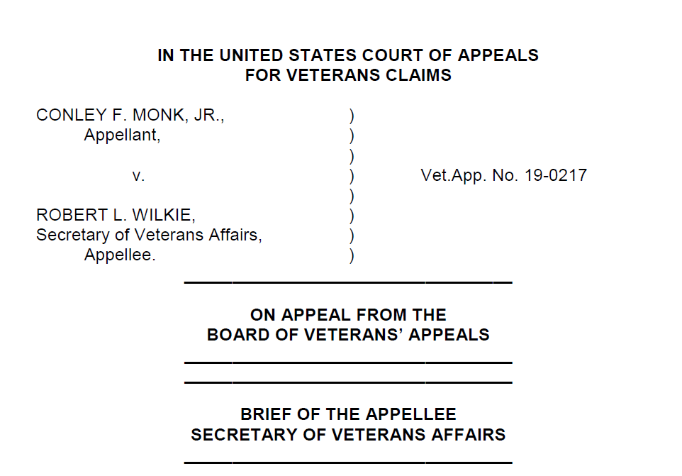

Slide 8
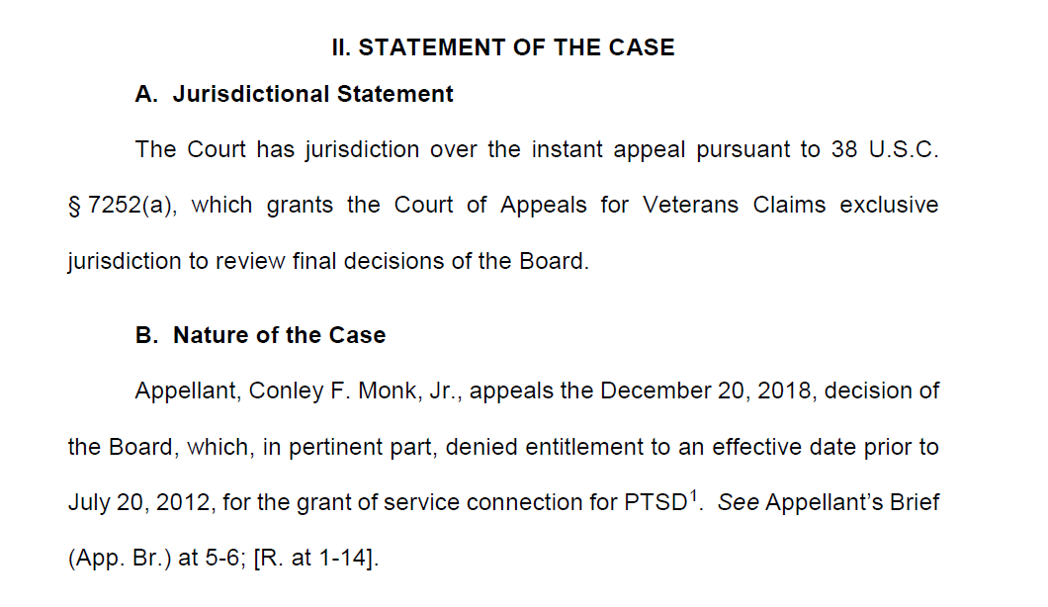

Slide 9
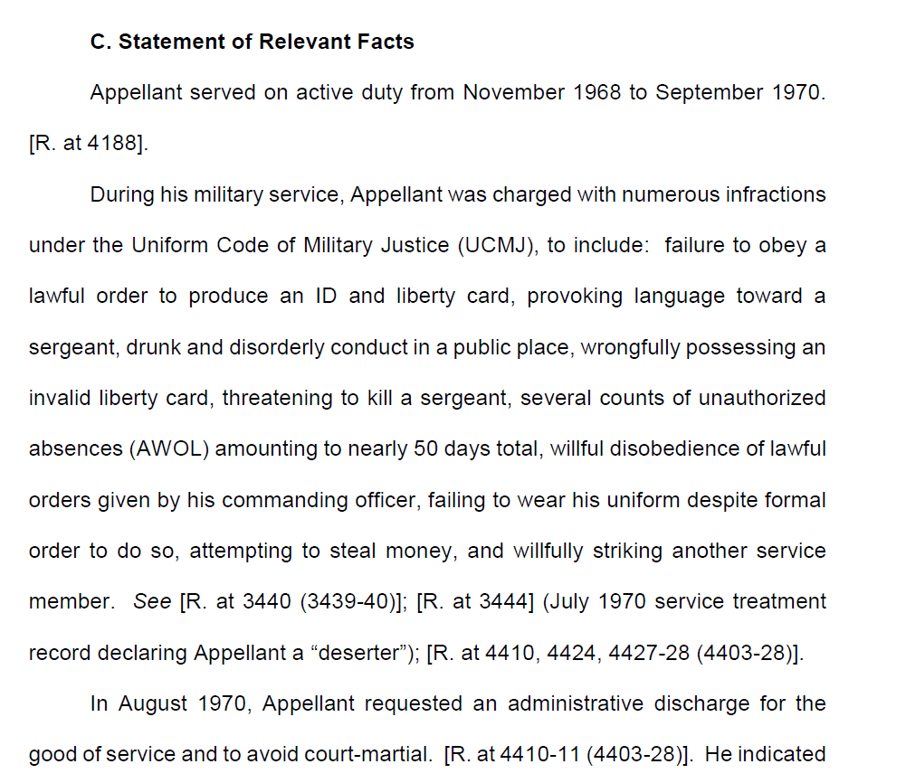

Slide 10
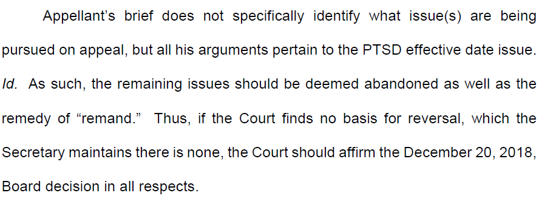

Slide 11
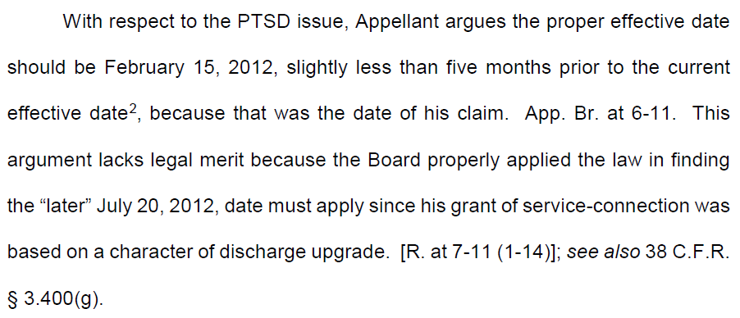

Slide 12
What’s the government’s theory of the case in Monk?
This Court reviews Board decisions for reversible error only. It need not and should not credit the Appellant’s lawyers’ underdeveloped and unsupported theory that the plain text of a regulation setting the effective date for compensation as the date of the discharge upgrade application does not mean what is says.
Narrative Framework
Steady State: Civil servants at the Board dutifully apply the law.
Trouble: Law students bring absurd legal theory to the Court
Hero: The Veterans’ Court
Temptation: The law students’ theory
Maybe also: awarding additional compensation to elderly, ill Vietnam combat vet
Resolution/Steady State: The Board’s decision is affirmed.

Slide 13
What is your theory of the case?
Jamie is a U.S. Army veteran who was diagnosed with mild lumbosacral strain after an accident while deployed in 2015. She continued to experience back pain whenever she bent over or exercised, but didn’t seek further treatment while in the Army. Stateside, Jamie began to experience symptoms of depression and anxiety; she began drinking as an escape.
Shortly after her discharge in 2017, Jamie started seeing a private chiropractor and a VA therapist. In March 2019, Jamie filed an initial claim for back pain, and depression and anxiety with alcohol use disorder.
In April 2019, Jamie was driving while intoxicated and crashed her car.
In July 2019, Jamie had a VA C&P exam. The DBQ shows the examiner didn’t review her chiropractic records. He ordered an MRI and diagnosed Jamie with severe lumbosacral strain, but asked her only about the recent crash and her symptoms after. He opined that the 2019 crash was the cause of her injury. VA denied Jamie’s back pain claim, but granted her mental health claim.
Jamie appealed to the BVA, arguing the C&P exam was a failure of VA’s duty to assist. Jamie lost, and now appeals to the CAVC.

Slide 14
Email Us Two Sentences
Michael.Wishnie@yale.edu
Meghan.Brooks@yale.edu

Slide 15
Questions?

